Slide 1
ConnectLife
A social media website
-16BCE0366

Slide 2

Project Guide
Guide Name: Dr. R. Sathyaraj
Designation: Assistant Professor Sr. Grade 1
Mail ID: sathyaraj@vit.ac.in

Slide 3
What?

Slide 4
What?
Social media revolution is about to shift into override.
An educational social media website which is a platform that helps people connect virtually within VIT.
Full administrative control for the administrators.

Slide 5
Technologies Used
HTML (Hypertext Markup Language)
CSS (Cascading Style Sheet)
Bootstrap
JS (JavaScript)
PHP (Hypertext Pre-processor)
Ajax (Asynchronous JavaScript and XML)
SQL (Structured Query Language)

Slide 6
Softwares Used
XAMPP
[ Cross-Platform (X), Apache (A), MariaDB (M), PHP (P) and Perl (P) ]
Text Editor like Sublime Text, Notepad++
Web Browser like Google Chrome

Slide 7
Why?

Slide 8
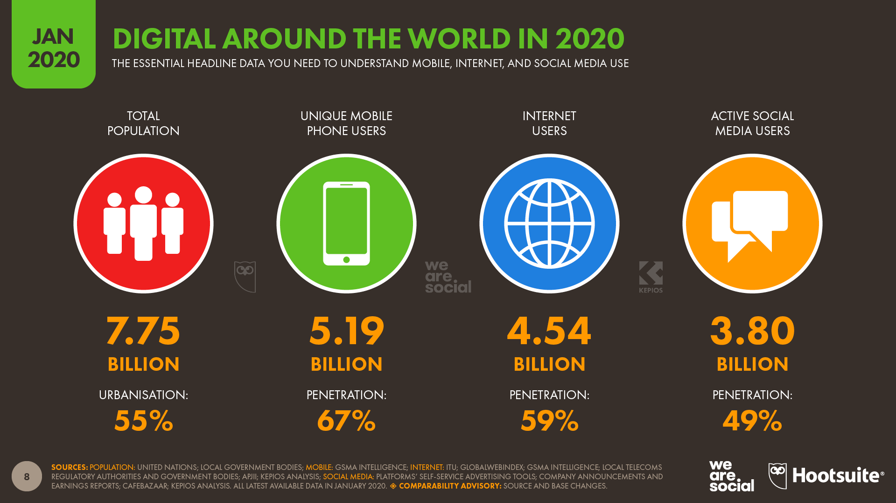
Why?
Digitalization & Emerging Field

Slide 9
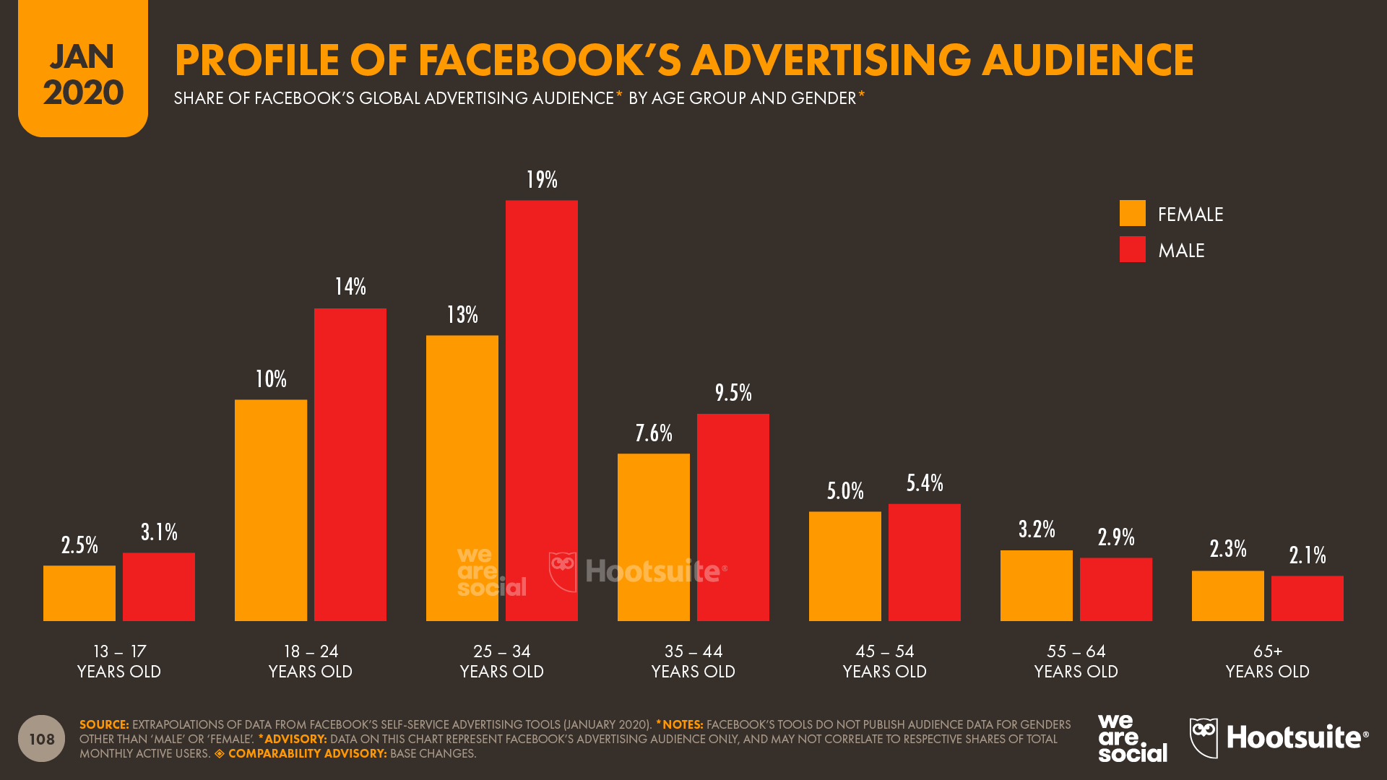
Why?
Connecting people of different Age group & Ethnicity

Slide 10
Why?
No content sharing portal restricted to VIT that has full administration with content monitoring .
VIT can have full access on what people do & who uses the portal that connects every VITian to be part of the community, enabling the juniors to connect to seniors.

Slide 11
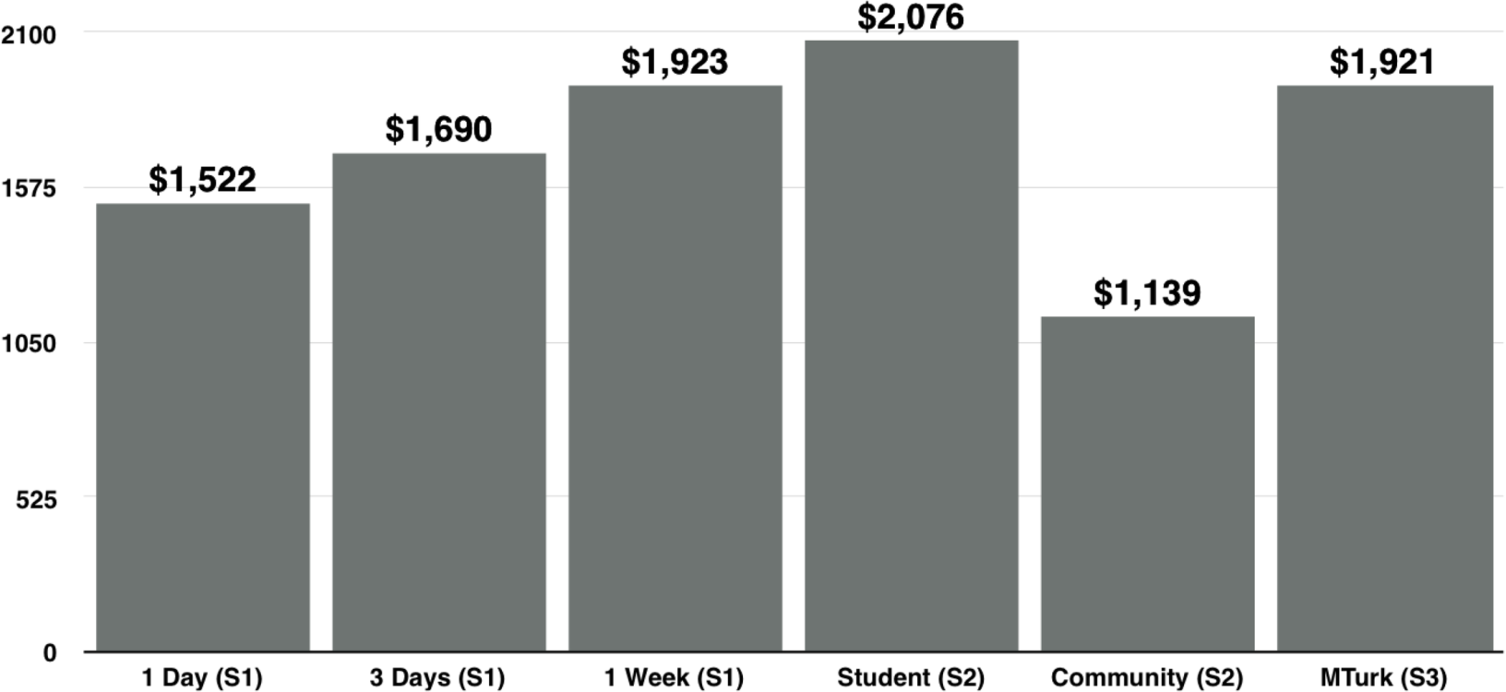
Why?
Revenue from Advertising & AdSense, Affiliate & Digital Marketing

Slide 12
What’s New?

Slide 13
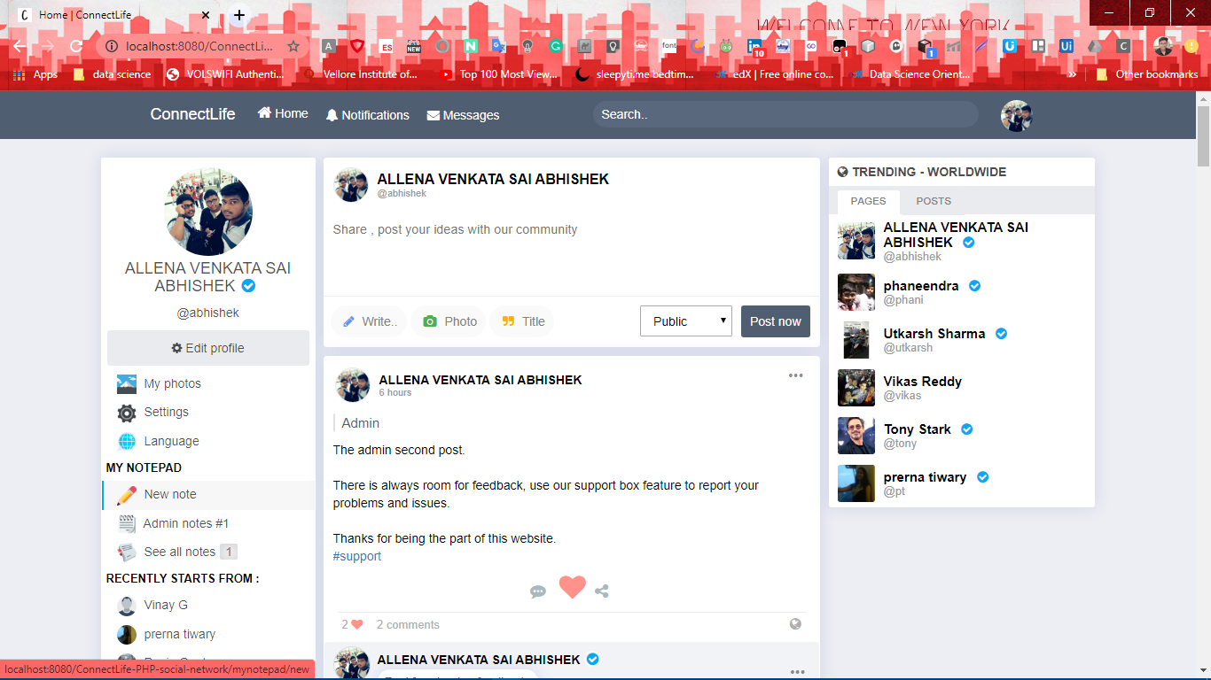
What’s New?
Notepad Feature

Slide 14
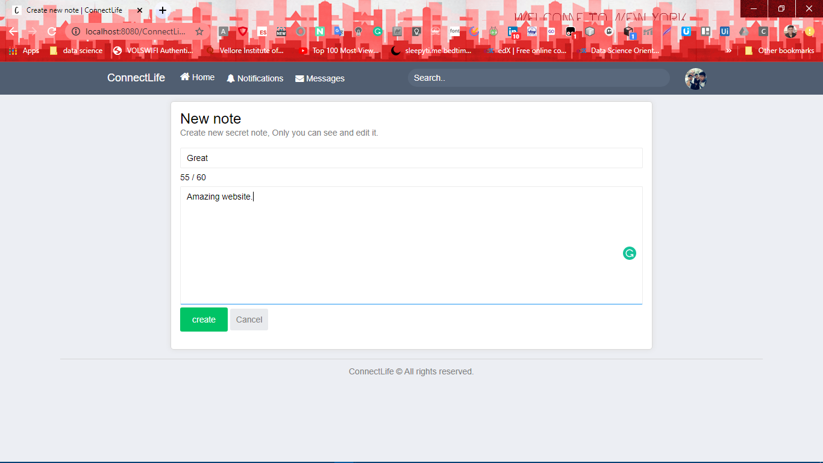
What’s New?

Slide 15
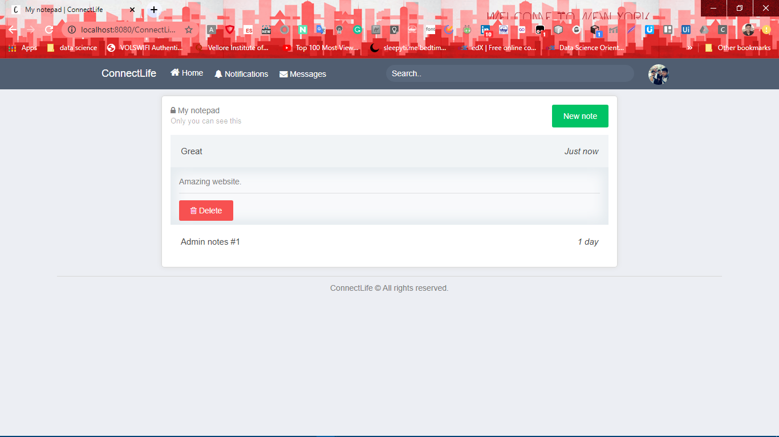
What’s New?

Slide 16
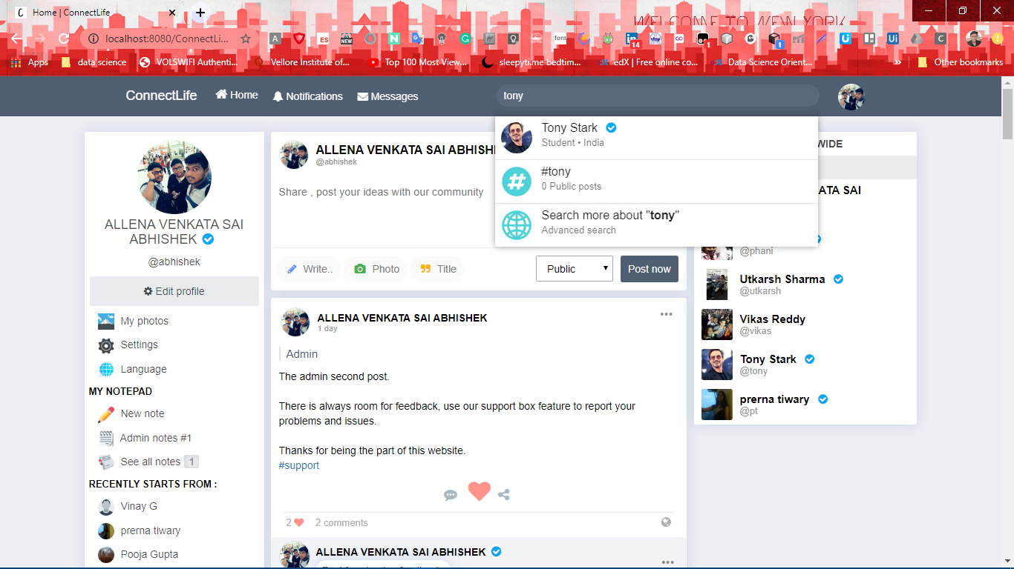
What’s New?
Functional Search Bar with Hastag searches too

Slide 17
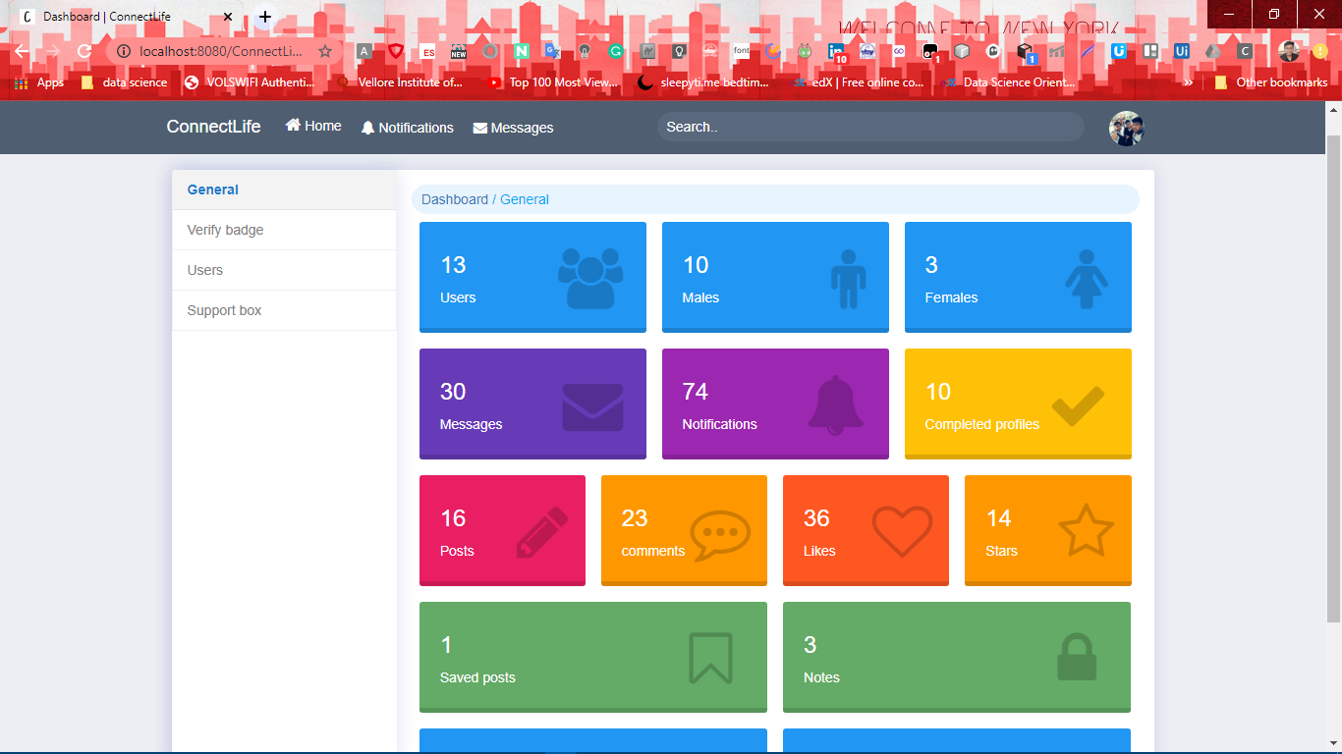
What’s New?
DashBoard for Admin with full access

Slide 18
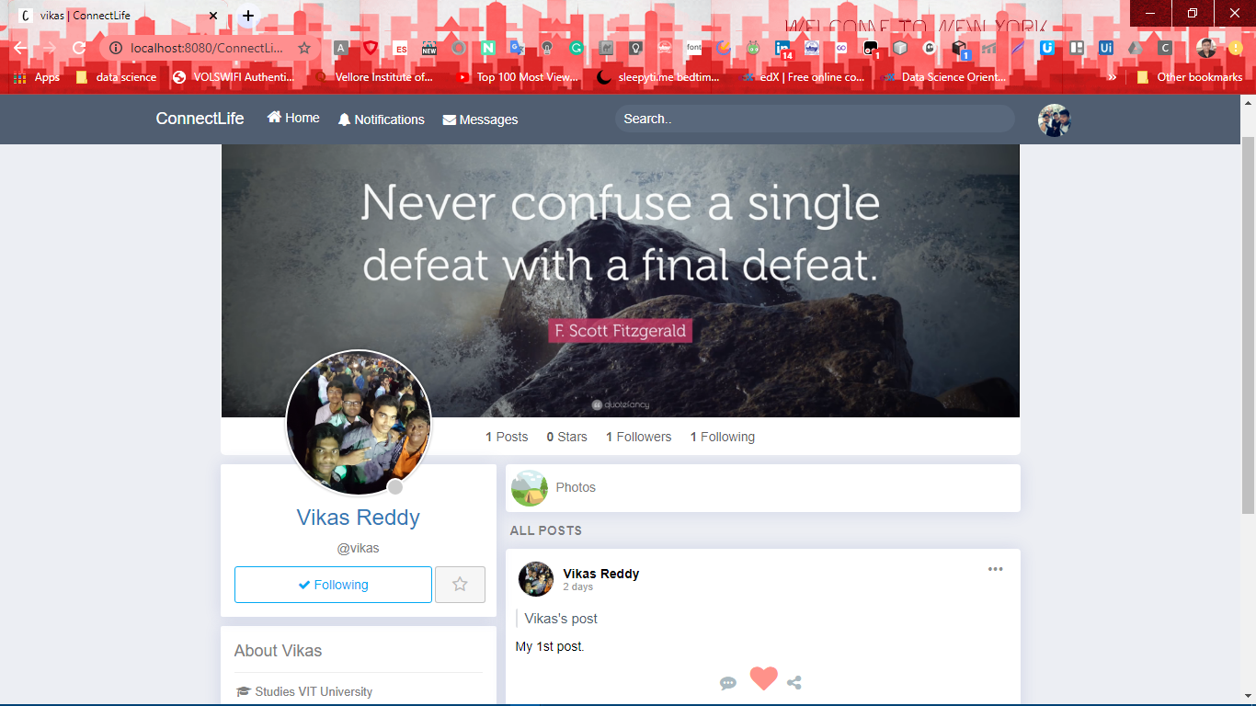
What’s New?
Add somone as your Favourite friend

Slide 19
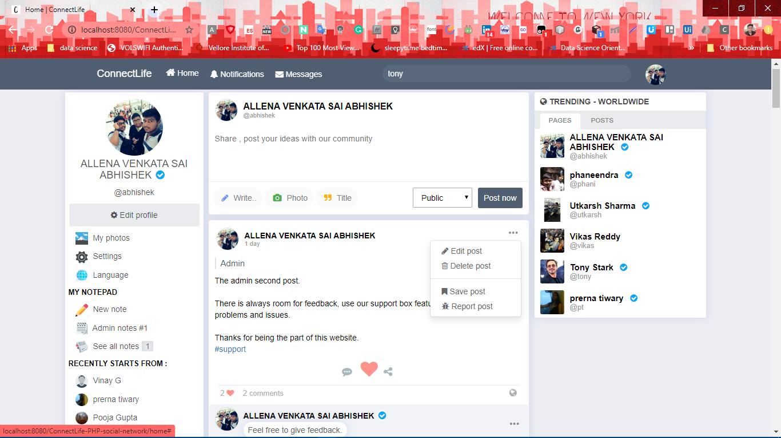
What’s New?
Save & Share a Post

Slide 20
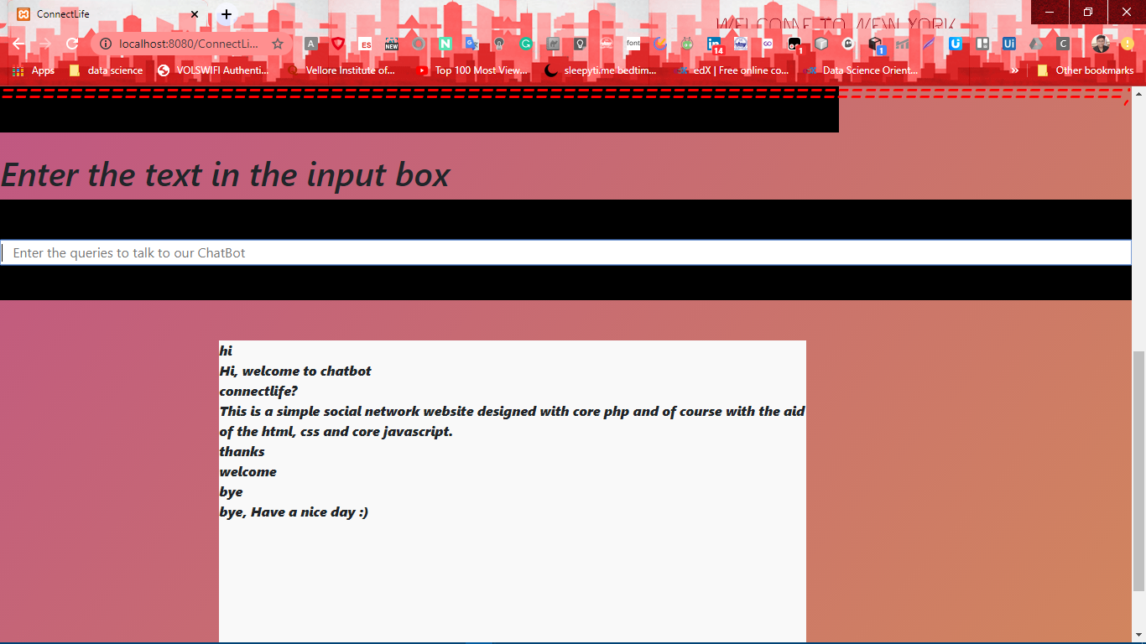
What’s New?
ChatBot Feature

Slide 21
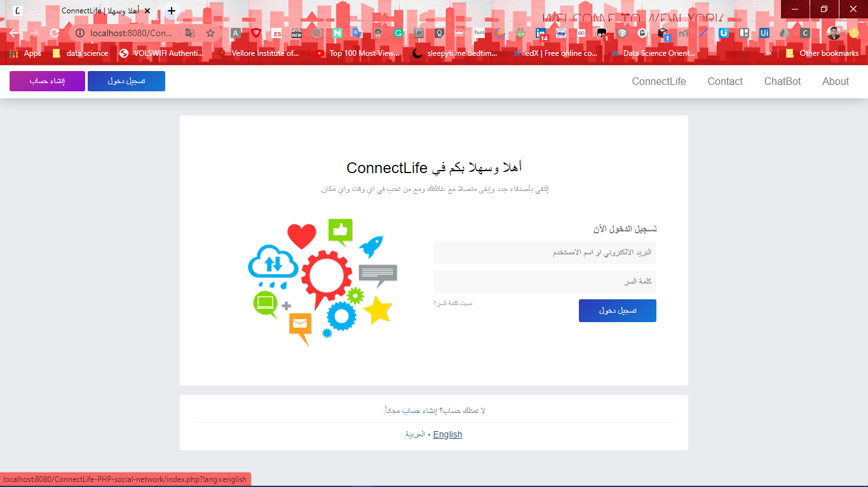
What’s New?
Bilingual Page

Slide 22
What else?

Slide 23
What’s Else?
Real-Time Notification
Create, like & comment on post
Edit profile feature for users
Support Box feature for feedback & Report a problem to admin
Profile Completion Feature
Messaging with Emoji’s

Slide 24
How?

Slide 25
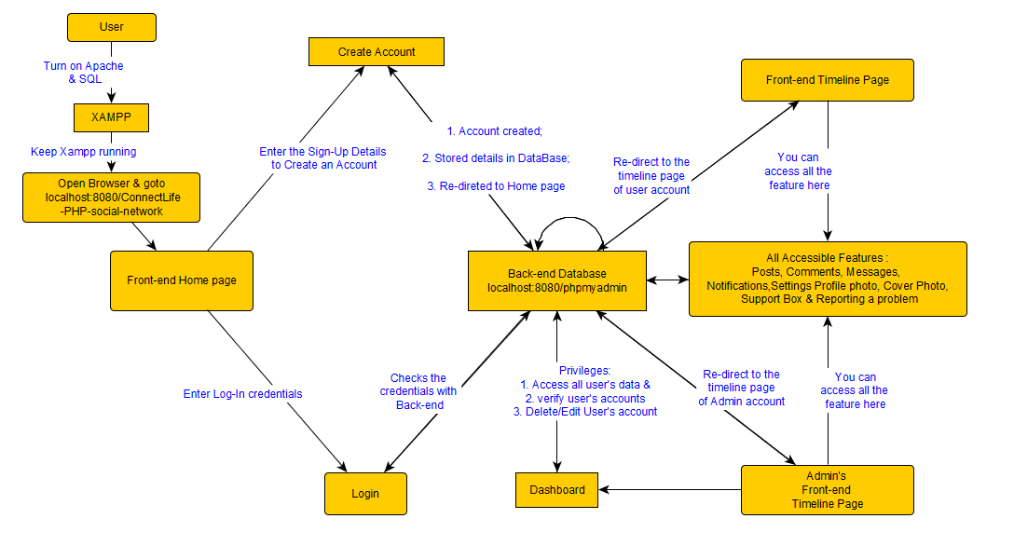
How?

Slide 26
Where?

Slide 27
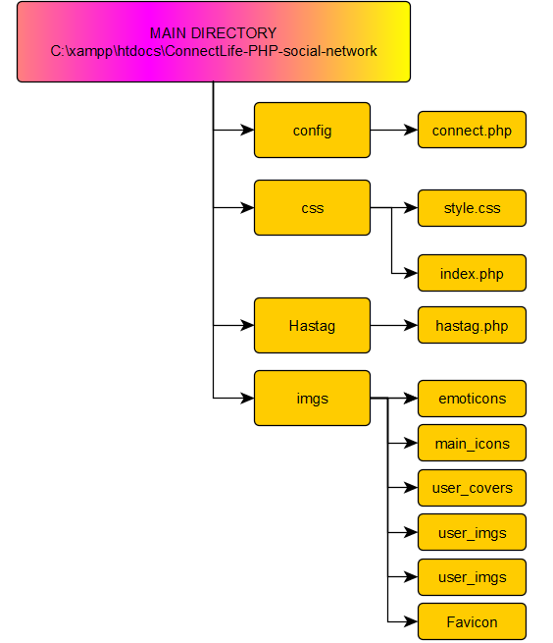
Where?
The main folders & it’s contents

Slide 28
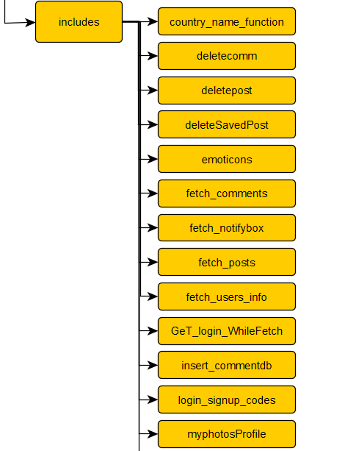
Where?
The includes folders & it’s contents

Slide 29
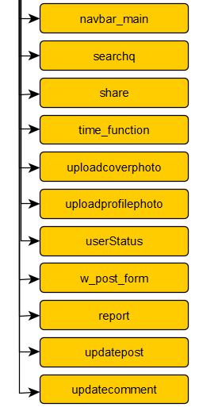
Where?
The includes folders & it’s contents

Slide 30
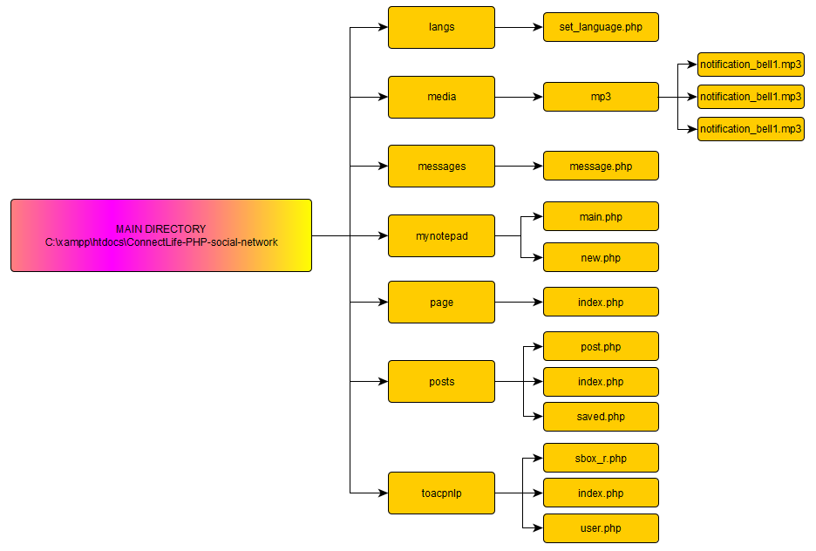
Where?
The main folders & it’s contents

Slide 31
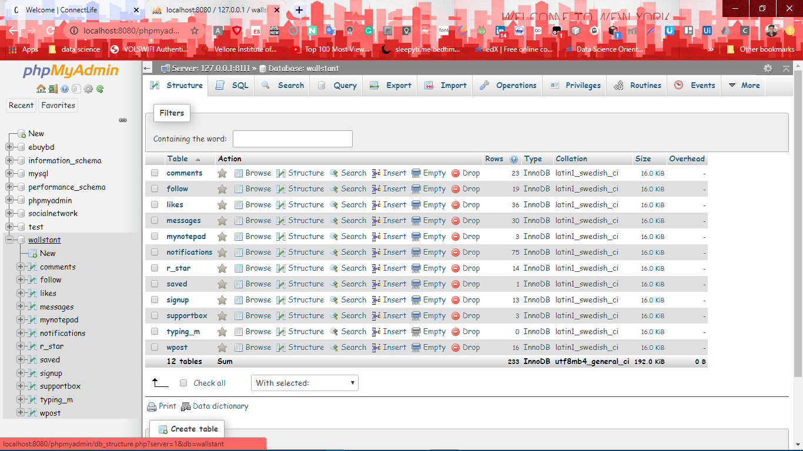
Where?

Slide 32
When?

Slide 33
When?
Timeline | Duration | Milestones
Week 1-2 | 24th Nov’19 - 10th Dec’19 | Research Work
Week 3-5 | 11th Dec’19 - 31st Dec’19 | Topic selection and submission
Week6-8 | 1st Jan’20 - 24th Jan’20 | Laying up the blueprint of the website
Week 9 | 25th Jan’20 - 28th Feb’20 | Data collection & analyzing tradeoffs
Week 10-12 | 29th Feb’20 - 18th Mar’20 | Starting with coding for home page
Week 13 | 19th Mar’20 - 27th Mar’20 | Configurating database functionalities
Week 14-15 | 28th Mar’20 - 10th April’20 | Executing sign up & log in
Week 16-17 | 11th April’20 - 22nd April’20 | Implementing features one by one
Week 18-20 | 23rd April’20 - 14th May’20 | Resulting project & development
Week 21-23 | 15th May’20 - 28th May’20 | Testing & Debugging

Slide 34
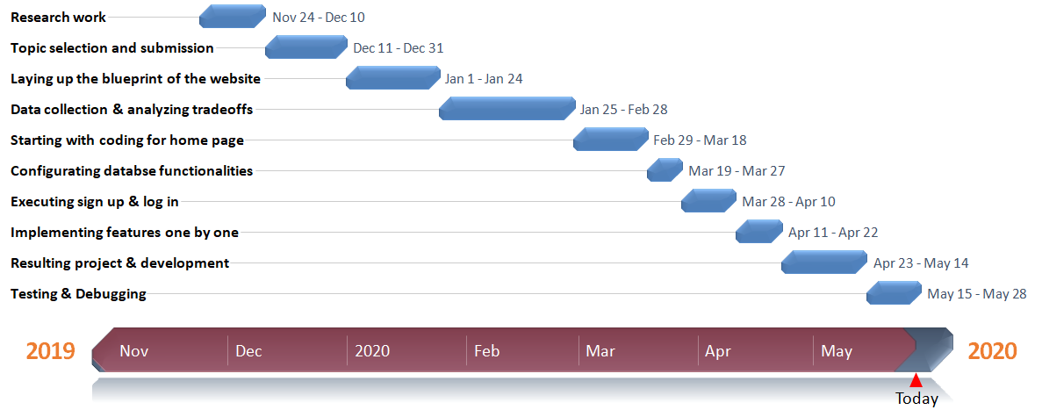
When?

Slide 35
Let Me Show You A DEMO

Slide 36
Thank You

